Slide 1
Cyclistic-bike share
Presented by: Rion Sutradhar
Last Updated: 23-06-2024

Slide 2
Table of Contents
Purpose Statement
Story (with Data!)
Conclusion
Appendix

Slide 3
What are we talking about?

Slide 4
Objective
Identifying trends about how casual and member riders use the Cyclistic bikes differently and also addressing the possible factors that could play a role in it.

Slide 5
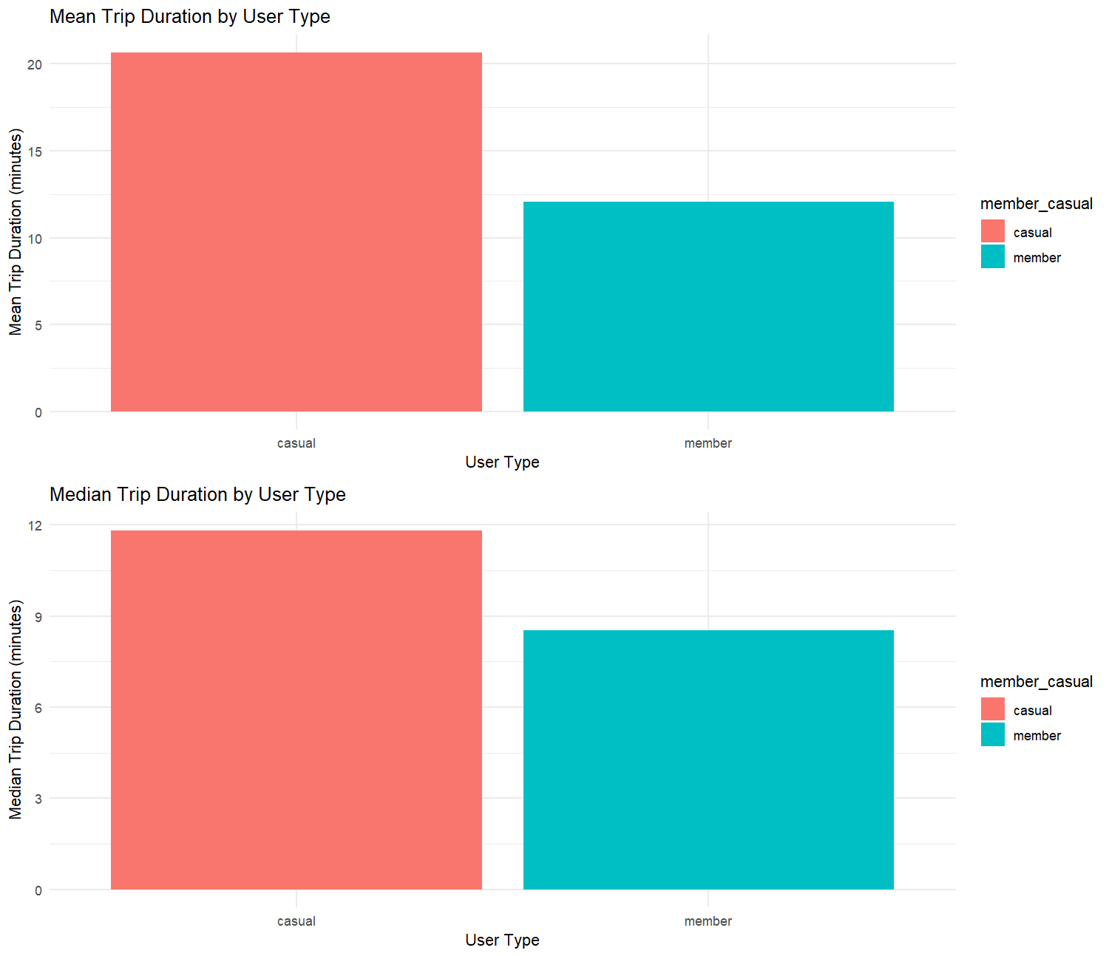
Mean and Median of Trip Duration
Casual riders tend to ride for a longer duration of time than member riders.
No reason as to why casual riders ride more than member riders.

Slide 6
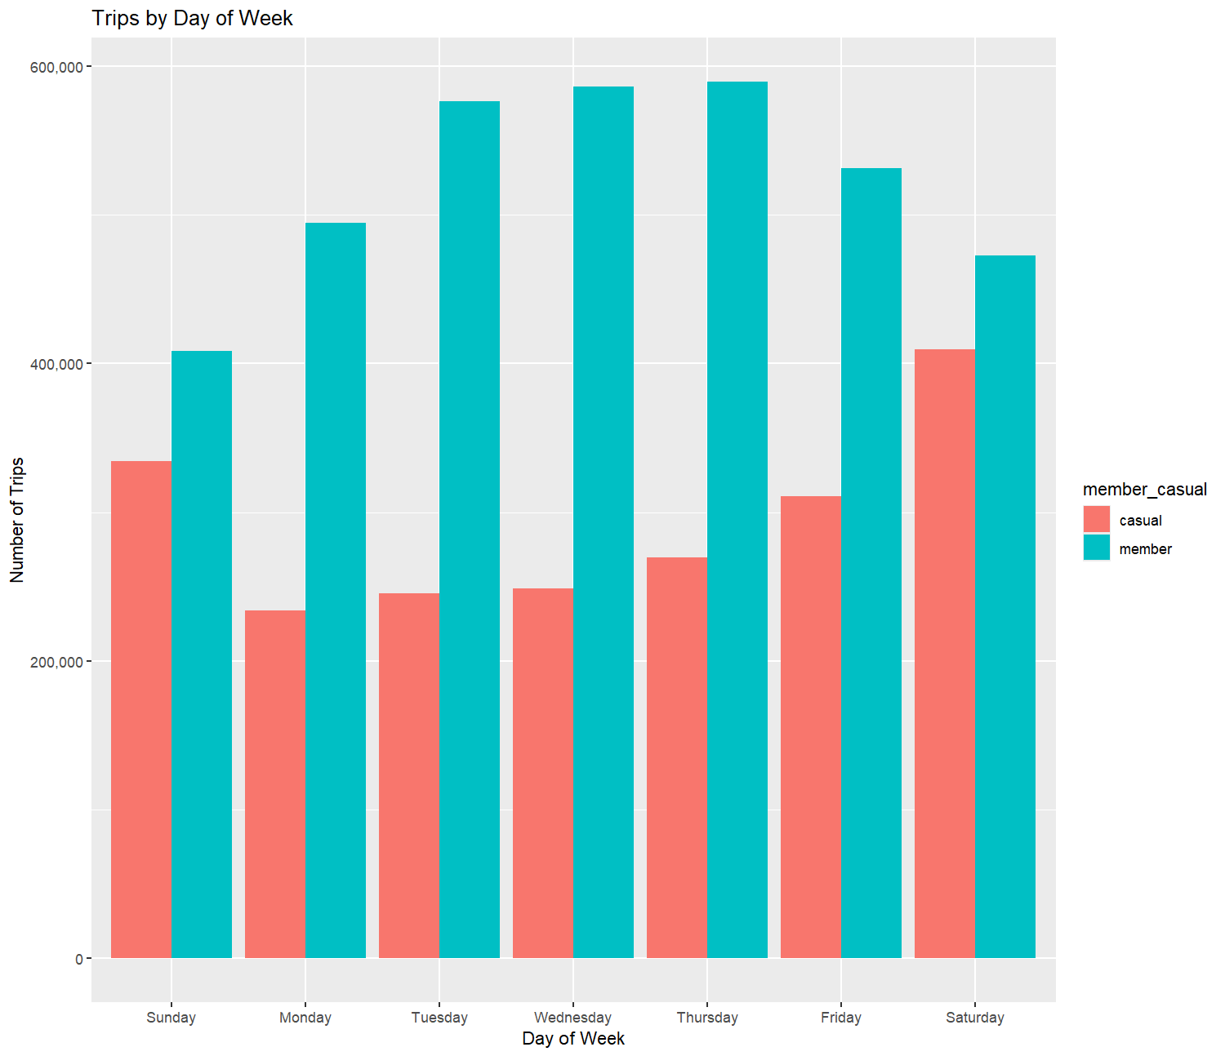
Trips by Day of Week
Total trips by member riders are more than casual riders on any day.
Member riders tend to make more trips on weekdays whereas casual riders tend to make more trips on weekends.
A possible reason can be that member riders use the bikes for daily commute whereas casual riders use the bikes for weekend outings.

Slide 7
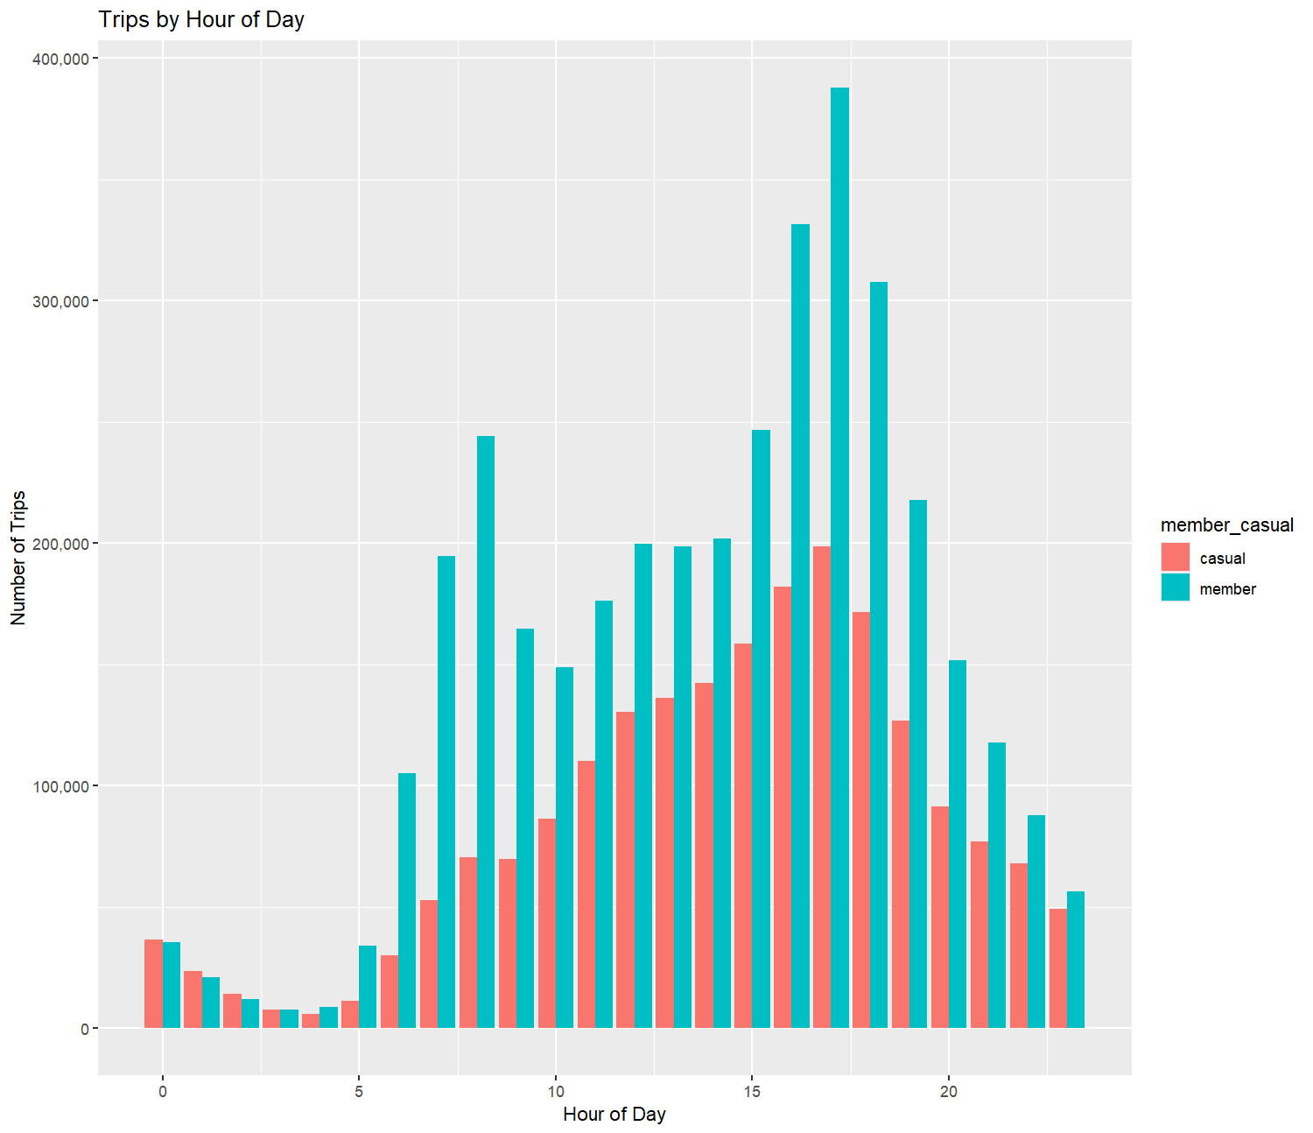
Trips by Hour of Day
Casual riders has a steady increase in number of trips as the day goes by.
Member riders take more trips during 8AM and 9AM and then it again increases during 4PM - 6PM.
This does support our hypothesis that members tend to use the platform for daily commutes.

Slide 8
Conclusions
01
Individual trip durations are more for casual members as they use it for weekend outings.
02
Member riders use the platform for daily commutes as they take more trips during weekdays.
03
This is further backed up by the fact that casual members do not have a specific time frame during which they use the platform.

Slide 9
Some recommendations
We can market the platform to show the casual riders the benefit of getting the membership.
Benefits include the use case of daily commute without any extra cost.
Casual riders also get to enjoy their weekend rides for much cheaper prices than they had to pay for individual trips.

Slide 10
Thank you
I’m open to questions

